Slide 1
Web - IIS を参考程度に…

Slide 2
Web

Slide 3
Request と Response
HTTP Request
HTTP Response
GET https://azure.microsoft.com/ja-jp/ HTTP/1.1
Host: azure.microsoft.com
Connection: keep-alive
Upgrade-Insecure-Requests: 1
User-Agent: Mozilla/5.0 (Windows NT 10.0; Win64; x64) AppleWebKit/537.36 (KHTML, like Gecko) Chrome/79.0.3919.0 Safari/537.36 Edg/79.0.297.0
Accept: text/html,application/xhtml+xml,application/xml;q=0.9,image/webp,image/apng,*/*;q=0.8,application/signed-exchange;v=b3
Sec-Fetch-Site: none
Sec-Fetch-Mode: navigate
Accept-Encoding: gzip, deflate, br
Accept-Language: ja,en-US;q=0.9,en;q=0.8
HTTP/1.1 200 OK
Cache-Control: no-cache
Keep-Alive: timeout=10, max=100
Pragma: no-cache
Content-Type: text/html; charset=utf-8
Expires: -1
X-MSEdge-Features: 44276-control,87131-1940v2
Date: Tue, 08 Oct 2019 10:29:30 GMT
Content-Length: 258479
<!DOCTYPE html>
<html class="ja ja-jp" lang="ja">
<head>
<meta charset="utf-8" />
<meta http-equiv="X-UA-Compatible" content="IE=edge" />
<meta name="viewport" content="width=device-width, initial-scale=1">
<meta name="description" content="Microsoft Azure はオープンで柔軟な、エンタープライズ レベルのクラウド コンピューティング プラットフォームです。IaaS と PaaS を使用すると、スピードや効率が上がり、コストを削減できます。無料で試す。" />
<meta name="keywords" content="Azure, Windows Azure, Cloud Service, Cloud Computing Companies" />
…

Slide 4
HTTP の大原則
テキスト
Hyper TEXT Transport Protocol
ブラウザーが HTML レンダリングする
Response を返したら、処理終了
Stateless – Server 側は軽い
W3C / DOM という標準化
仕様はある!
今ある技術は全てすごい!

Slide 5
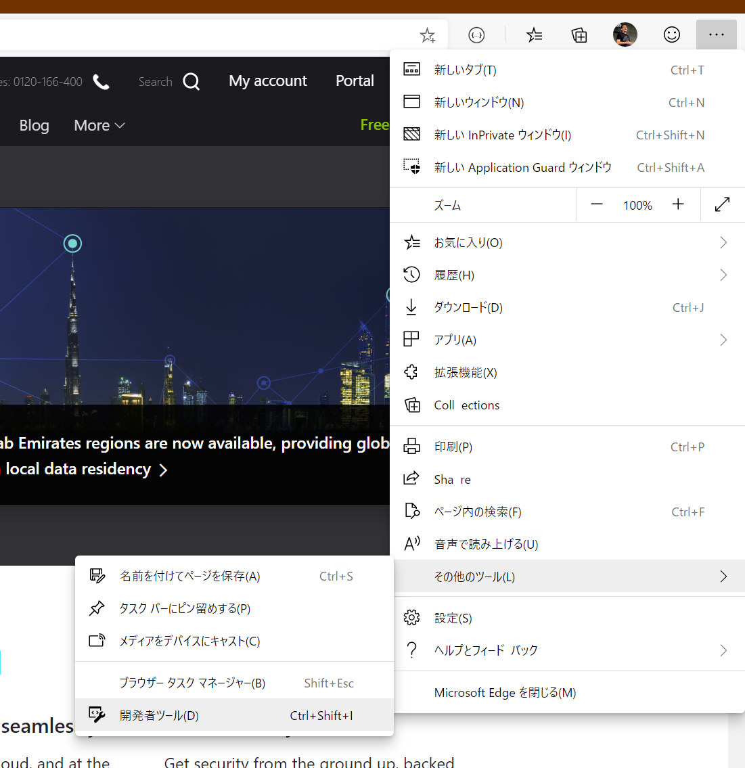
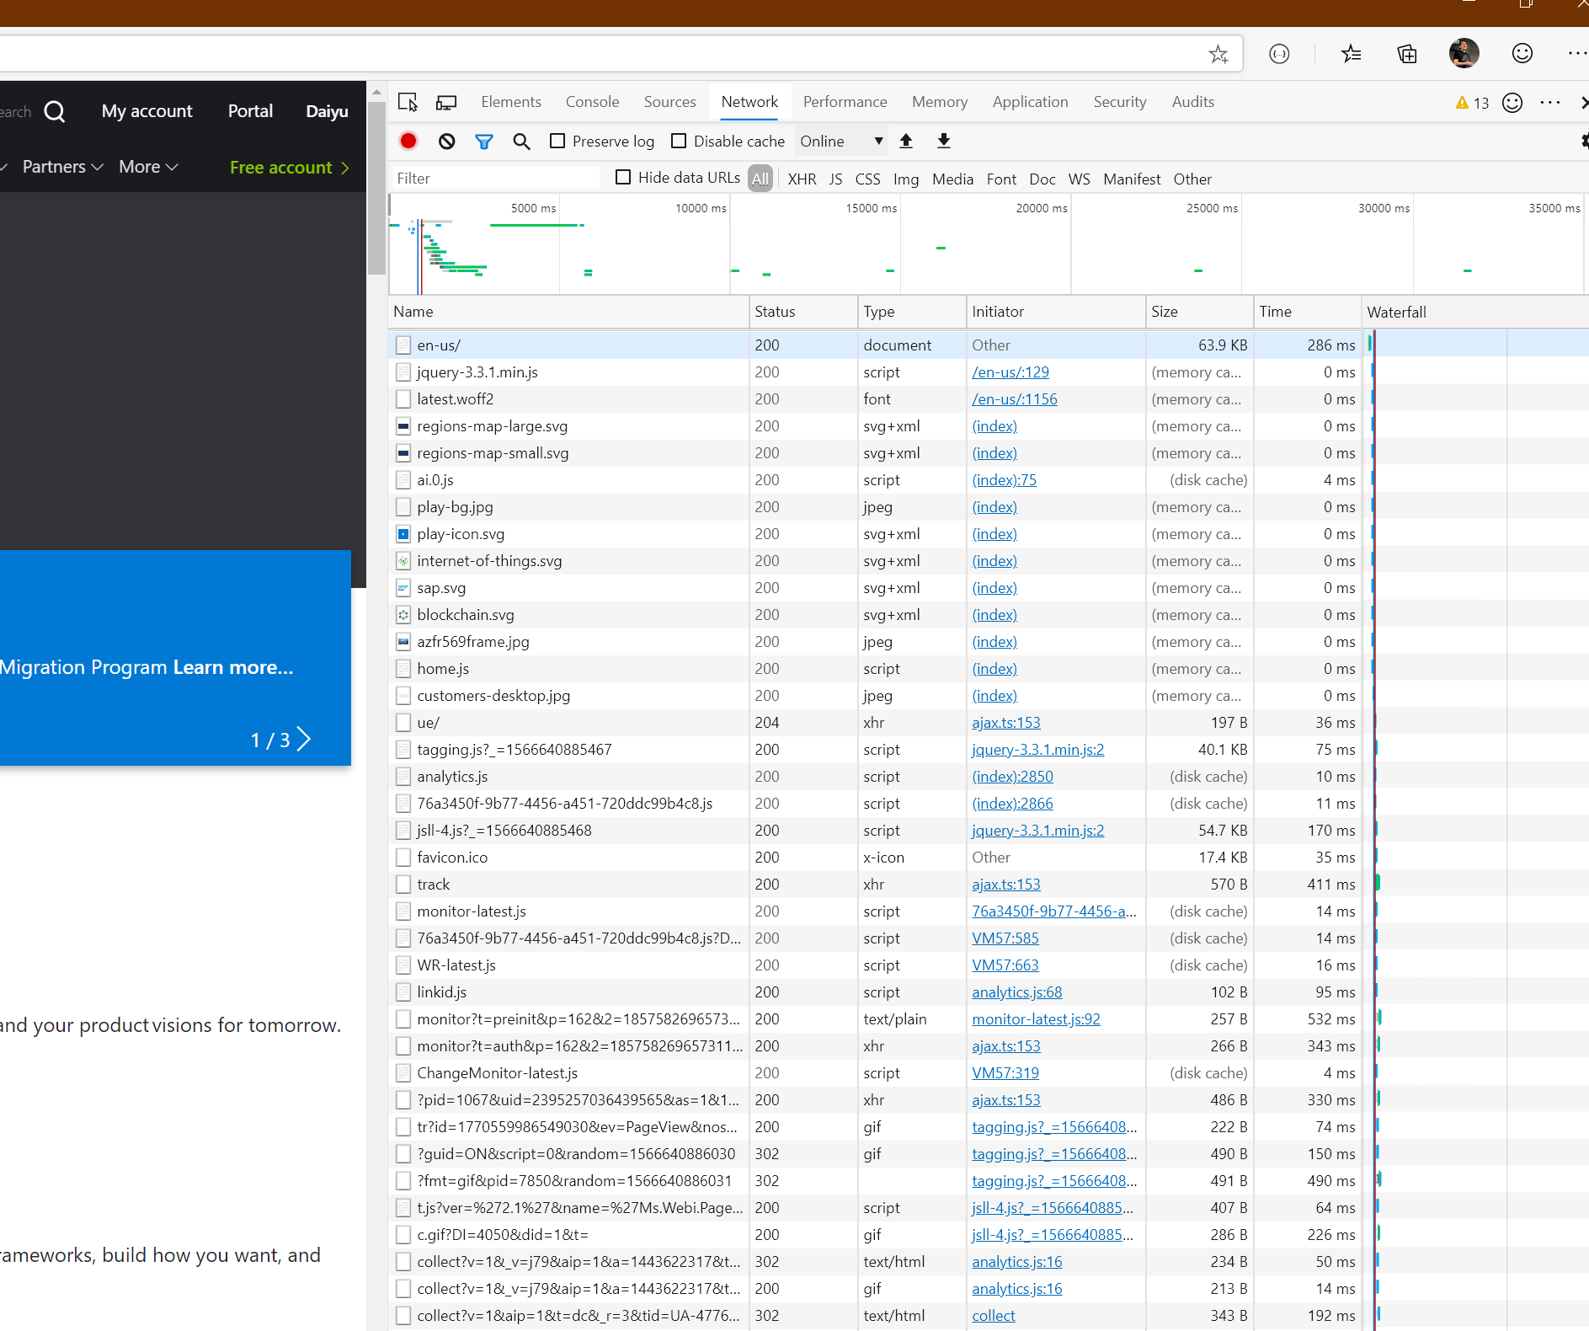
Web ブラウザー でHTTP通信は簡単にトレースできる

Slide 6
HTTP の限界を打ち破る挑戦
Adobe Flash, Microsoft Silverlight
HTML5

Slide 7
ASP.NET Architecture
Compiled
Compiled
.ASPX
.ASPX

Slide 8
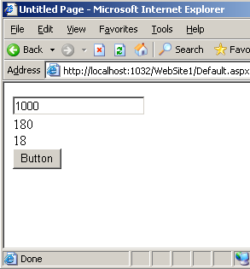
Sample Web Application
protected void Button1_Click(object sender, EventArgs e)
{
int intMax, intNumber, intLoop, intCount = 0;
bool boolPrime;
intMax = Convert.ToInt32(TextBox1.Text);
for (intNumber = 1; intNumber < intMax; intNumber++)
{
boolPrime = true;
for (intLoop = 2; intLoop < Math.Sqrt(intNumber);
intLoop++)
{
if (intNumber % intLoop == 0)
{
boolPrime = false;
break;
}
}
if (boolPrime) intCount++;
}
Label1.Text = Convert.ToString(intCount);
Label2.Text = Convert.ToString(intCount *
100 / intMax);
}

Slide 9
IIS

Slide 10
IIS の変遷の歴史 －大きな変更ポイントについて
 | 2000 | 2003 | 2003 R2 | 2008 | 2008 R2
 | IIS 5.0 | IIS 6.0 | IIS 6.0 | IIS 7.0 | IIS 7.5
① 汎用ワーカプロセス | 汎用ワーカプロセスなし | 汎用ワーカプロセス w3wp.exe
② パイプライン動作 | 独立パイプライン |  |  | 統合パイプライン
③ OS の 64 ビット化 | 32 ビット版のみ | 32, 64 ビット版の両方が存在 |  |  | 64 ビット版のみ
④ .NET Framework | 1.1, 2.0 | 1.1, 2.0, 3.0, 3.5 |  |  | 2.0, 3.0, 3.5
⑤ 管理ツール | IIS/ASP.NET 個別管理 |  |  | IIS/ASP.NET 統合管理

Slide 11
IIS6.0 アーキテクチャ ワーカー プロセスとアプリケーション プール

Slide 12


IIS Process Model
LSASS.exe
Svchost.exe
Configuration Store
(applicationhost.config)
Windows
Auth
Application
Host Helper Service
(AppHostSvc)
Inetinfo.exe
Svchost.exe
Svchost.exe
Web garden (n * w3wp.exe)
IIS Admin
Service
Application Pool (w3wp.exe)
FTP Service
Windows Process
Activation Service
(WAS)
Worker Process
Worker Process
Worker Process
metabase
emulator
FTP Service
Worker Process
SMTP Service
Managed Mods
Managed Mods
WWW Publishing
Service (w3svc)
ISAPI Extensions
ISAPI Extensions
ISAPI Extensions
NNTP Service
ISAPI Extensions
ISAPI Filters
ISAPI Filters
ISAPI Filters
ISAPI Filters
User
Winsock
HTTPAPI
Kernel
HTTP.SYS
SSL
Windows Auth
TCPIP.SYS
Notes:
The key components in IIS Process Model are:
HTTP.SYS driver
Kernel Mode component that sends HTTP(S) requests to the user mode and sends the response to the TCPIP.SYS driver
Also hosts SSL encryption/decryption functionality
Performs part of Windows Authentication when Kerberos is used
LSASS.EXE
Local Security Authority Subsystem Service
Generic Windows service that does any security policy enforcement work
IIS Architecture has borrowed this service for performing part of Windows Authentication optionally in the user mode
Inetinfo.exe
Used when IIS 6 Management Compatibility Role Service is installed
Used for legacy tools (ADSUtil, etc.) to provide forward compatibility
Also hosts SMTP functionality
Svchost.exe (FTP Service)
Unlike IIS6, FTP service in IIS7.5 and above resides in its own service host process
Application Pool
Serves as a logical container for hosting application(s) and a worker process (w3wp.exe) to process requests coming to these applications
Web Gardening is a type of application pool where instead of running a single worker process, multiple w3wp.exe are run
Web Gardening is a reliability feature and not a performance feature
Configuration Store
This is where the entire configuration resides
It is a system of multiple configuration files structured in a hierarchical way
The most important configuration file is applicationhost.config file
We will discuss this in detail in the upcoming sections
Svchost.exe (Application Host Helper Service)
This service host is used to host Application Host Helper Service
This service helps with configuration isolation and with automatic backups (more on this in the next module)
Svchost.exe (WAS and W3SVC)
Another service host process is used to host two services: Windows Process Activation Service (WAS) and World Wide Web Publishing Service (W3SVC)
These two components work as a glue binding everything together
We will discuss these two services in detail in the upcoming slides

Slide 13
Component interaction
Configuration Store
Worker Process
4
5
3
6
W3SVC
WAS
8
7
2
9
10
11
HTTP.SYS
1
12
Notes:
Request is picked up by HTTP.SYS.
HTTP.SYS informs W3SVC of the request.
W3SVC communicates with WAS to let it know of the request.
WAS, in turn, communicates with the configuration store to identify the application pool that would host the request.
The Configuration Store sends the information to WAS.
WAS then creates/updates the worker process.
Once the worker process is successfully up and running, it informs WAS of its status.
WAS lets W3SVC know of the availability of the worker process.
W3SVC lets HTTP.SYS know about the worker process.
HTTP.SYS sends the request to the worker process.
Worker process executes the request and sends the response to HTTP.SYS.
HTTP.SYS sends the response to the client.
This interaction takes place for the first request. However, once the worker process is running and information about it is updated in the HTTP Listener, HTTP does not have to talk to W3SVC. The request flow in this case is 1->10->11->12.

Slide 14
HTTP.SYS architecture
HTTPAPI (user mode)
User
Kernel
Listener
Request
Queue
Request
Queue
Request
Queue
Send
Response
Namespace
Mapper
HTTP Engine
HTTP Parser
Response
Cache
HTTP.SYS
TCPIP.SYS
Notes:
An HTTP or HTTPS request is received by TCPIP.SYS driver and is passed to HTTP.SYS.
The Listener component of HTTP.SYS runs the request through HTTP engine where it goes through HTTP parser to verify the validity for the request. The parser ensures that no malformed characters exist in it and that it follows the rules specified by the HTTP RFC
Namespace Mapper decides, based on the unique combination of Port, IP Address and Hostname of the request, which application pool the request belongs to.
Before sending the request to the corresponding Request Queue for the given application pool, the request goes through the Response Cache. If the response is already cached for the request, then the response is sent out to TCIPIP.SYS driver and the request ends there.
If the response is not cached, then the request enters the Request Queue. Each application pool has corresponding Request Queue for it inside HTTP.SYS driver. The default size of the Request Queue is 1000.
From the Request Queue, the request enters the User Mode and Application Pool picks up the request when the worker process is ready to process the request.
The response is sent back to HTTP.SYS where it enters Response Cache before sending out to TCPIP.SYS. Response Cache decides whether response can be cached on number of factors.
The HTTP Server API limits the kernel mode cache to requests that meet the following conditions:
The request verb is GET and the entire request is received.
The request must not have an entity body.
The HTTP protocol is version 1.0 or later.
The "Translate: f " header is not present.
Expect headers other than "Expect: 100-Continue" are not present.
The authorization header is not present.
The Range and If-Range headers are not present.
https://support.microsoft.com/en-us/kb/817445
Registry Key: HKLM\System\CurrentControlSet\Services\HTTP

Slide 15




ワーカプロセスとは何か
Web サーバ中核部から切り出された、アプリケーション動作プロセスを、 一般にワーカプロセスと呼ぶ
一般的に Web サーバでは、特定のアプリの障害やクラッシュによって、Web サーバが全面的に ダウンしないようにする必要がある
このため IIS では、Web アプリケーションの実行空間を、IIS 本体部分（中核部）から切り出して 動作させるモデルを採用している
ルーティング
DNA アプリ A
IIS
コア
ランタイム
ワーカー
プロセス
DNA アプリ B
特定のアプリケーションがクラッシュしても、Web サーバが全面的にダウンする
危険性は低い
.NET アプリ X
ワーカー
プロセス
.NET アプリ Y
ワーカー
プロセス

Slide 16






ワーカプロセスの機能 －プロセスリサイクリング機能について
事前に設定した条件や IIS サービスマネージャからの操作によって、 ワーカプロセスをリフレッシュすることができる
Web サーバ
古いワーカプロセス（pid = xxx）
リクエスト①
WebAppA の
アプリケーションドメイン
リクエスト②
リクエスト③
新しいワーカープロセスに処理を
引き継いでプロセスまるごと
リフレッシュする
（サービスは停止しない！）
新しいワーカプロセス（pid = yyy）
処理が
振り直される！
WebAppA 用の
新しいアプリケーションドメイン
リクエスト④
リクエスト⑤

Slide 17
構成ファイルのレイアウト
web.configファイル
IIS +
ASP.NET +
.NET Framework
IIS
ASP.NET
applicationHost.config
web.config
.NET
Framework
\Windows\system32\inetsrv\config\applicationHost.config
※ビルド 5384 は inetsrv 直下にある
root web.config
\Windows\Microsoft.NET\Framework\v2.0.50727\config\web.config
machine.config
\Windows\Microsoft.NET\Framework\v2.0.50727\config\machine.config
スキーマ：%windir%\system32\inetsrv\config\schema\
IIS_schema.xml, ASPNET_schema.xml , FX_schema.xml

